Slide 1









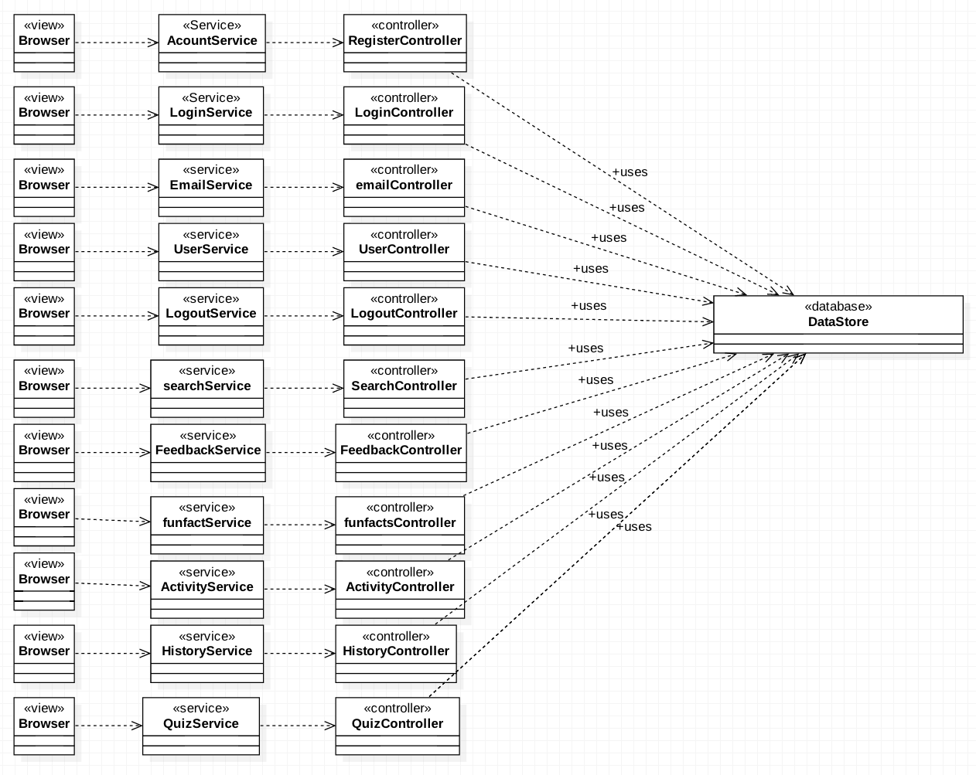
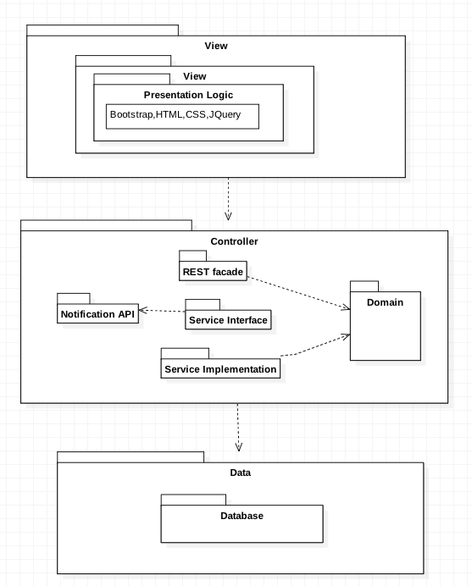
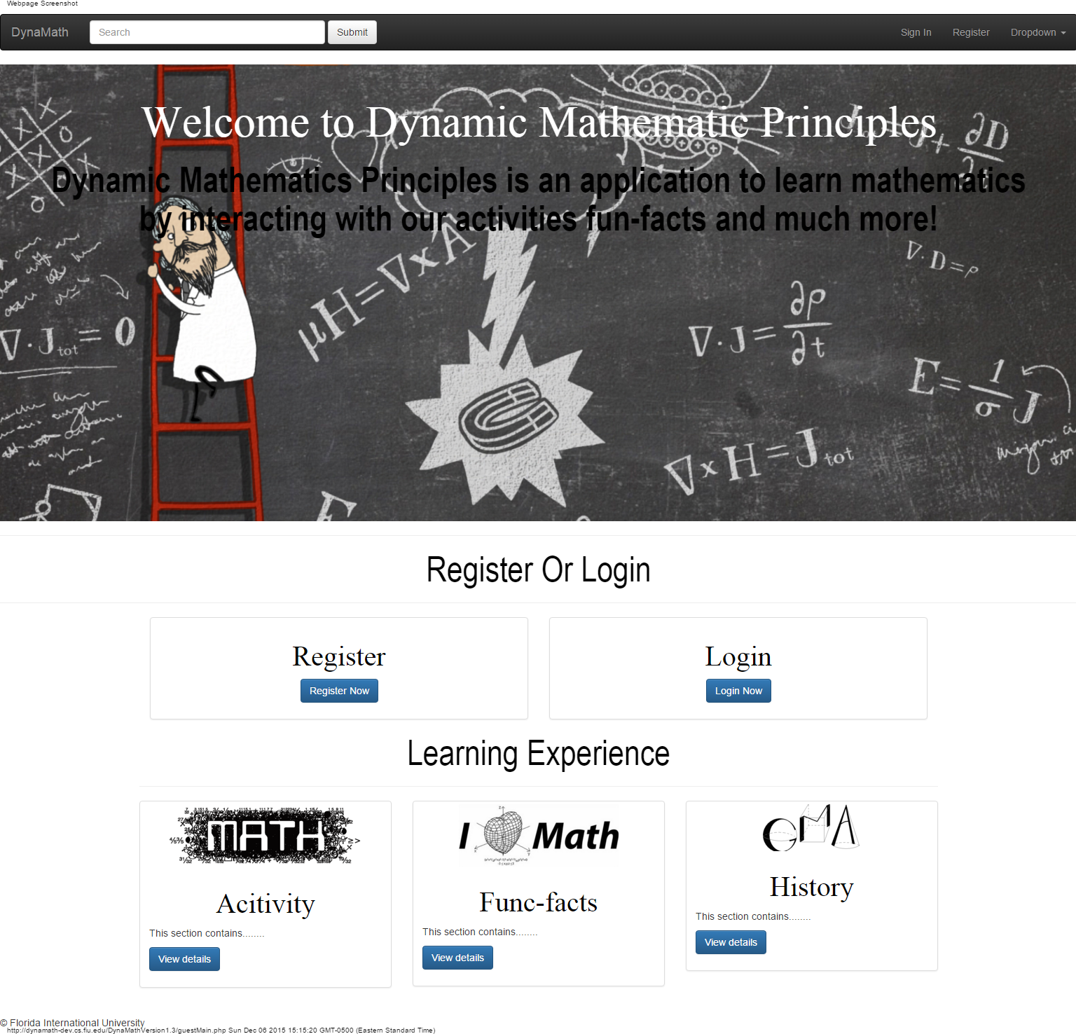
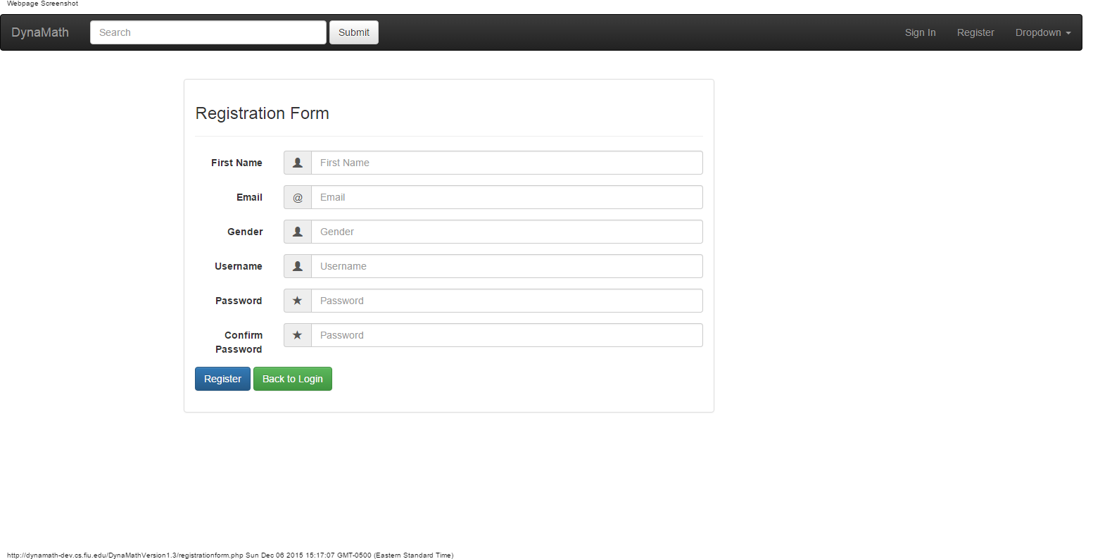
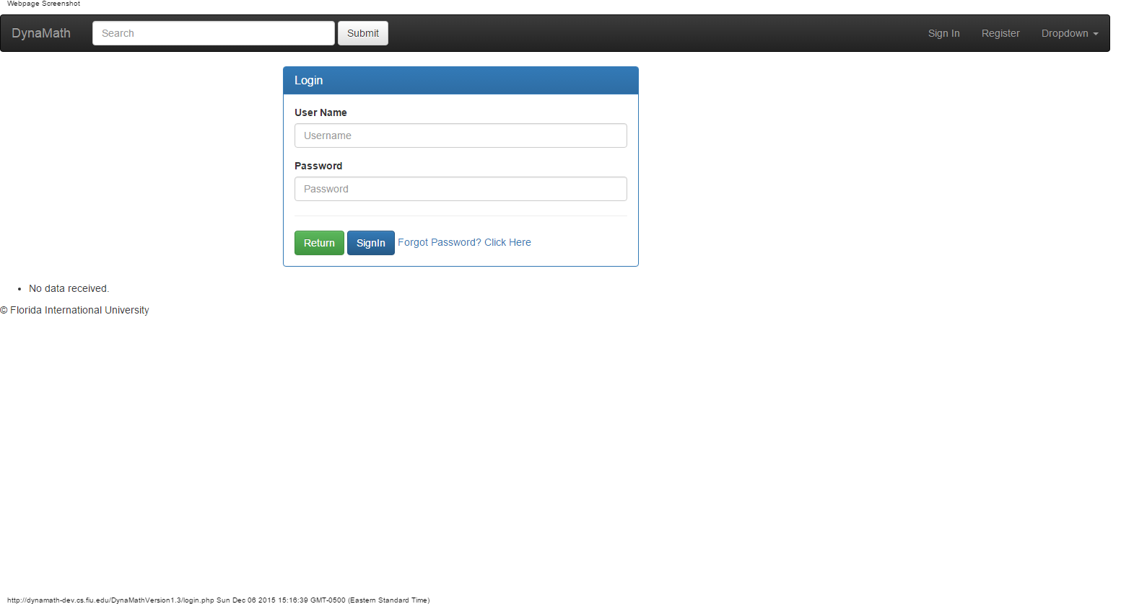
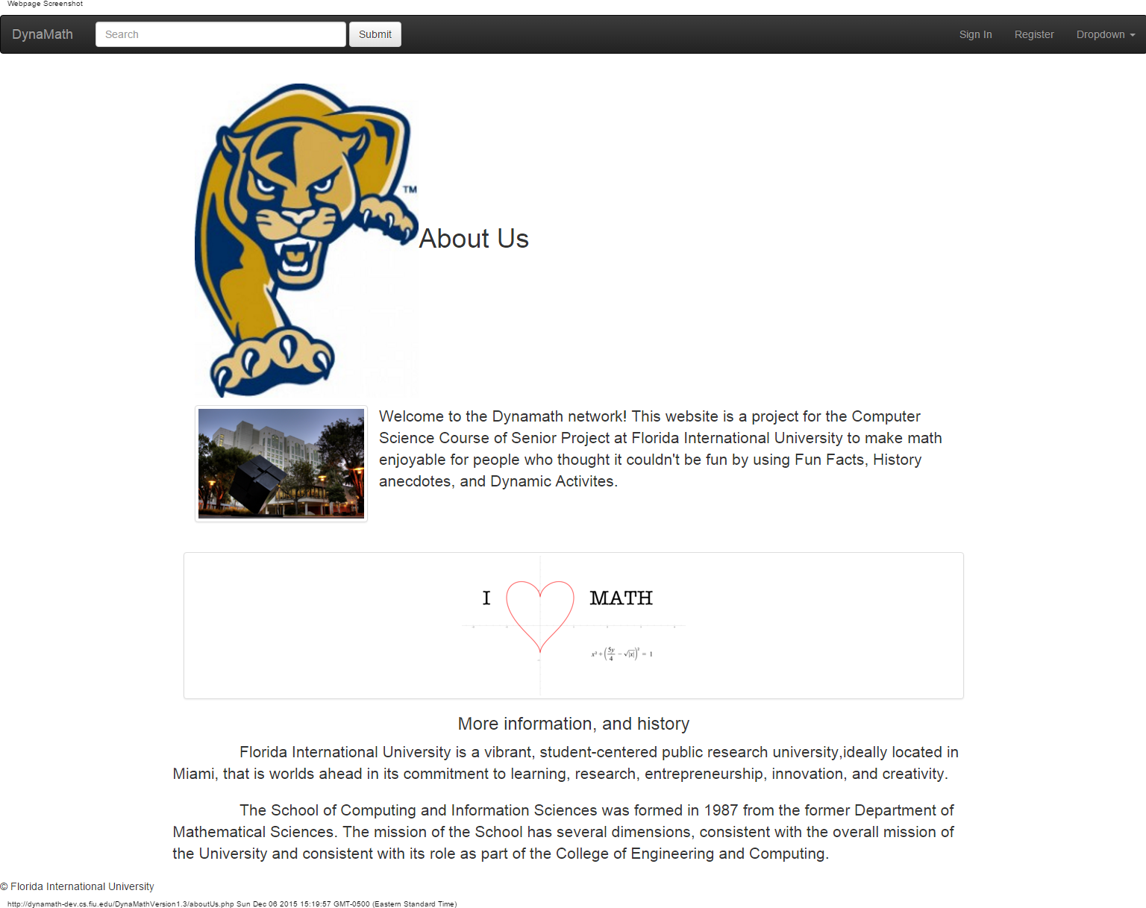
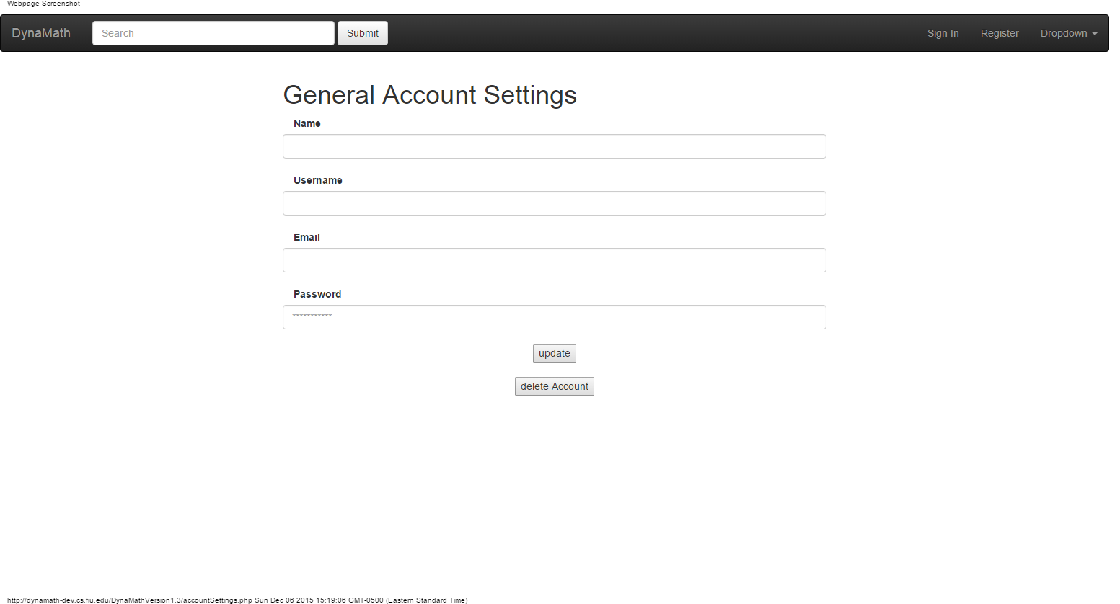
School of Computing & Information Sciences
Senior Project, 2015, Fall
Dynamic Mathematics Principles
Student: Ingrid Troche, Florida International University
Mentor: Mario Eraso, Florida International University
Instructor: Masoud Sadjadi, Florida International University
Problem
Current System
Requirements
The discipline of mathematics presents many challenges to different learners. A lack of sufficient mathematical skill and understanding affects one’s ability to make critically important educational, life, and career decisions. Our goal is to create a website were users can interact with our system to learn mathematical concepts dynamically and fun , giving them the chance to discover their new interests for mathematics.
There is no current system that provides this kind of functionality in FIU to the public. Currently the teaching methods used are typically passive abstract learning for enrolled college students. The limitations of this learning process are the lack of active engagement and as a consequence students move on without full understanding of the subject, closing their doors to great opportunities out there. This website will be created to increase the user opportunity of understanding mathematical knowledge. There are no previous versions of this system. This project will be initial code base of the system.
The system shall…
Allow user to register an account .
Allow user to login.
Allow user to logout from the system.
Allow user to modify account
Allow user to delete account
Allow user to send feedback.
Allow user to rate activity.
Allow user to view About Us page.
Allow user to interact with history page.
Allow users to interact with Fun-Facts page.
Allow users to interact with Activity page.
Allow users to take quizes
Allow users to view hints related to the activities.
Object Design
System Design
Object Design
Implementation
Sublime was development IDE used for
implementing the system.
The User Interface was done using CSS,BOOTSTRAP,HTML5. While the controller was done using PHP. Mysqli was also used for data storage through HTTP the system accesses.
.
Summary
The purpose of this project is to change people’s perspective towards mathematics. The website provides interactive activities,fun-facts and history pages to enhance the learning experience. It also includes other features such as an about us page,feedback page, rate activity, quizes and surveys. In conclusion this website is for educational purposes.
The Dynamic Mathematics Principles verification was done using Automated Testing (Selenium for automating UI testing), System Testing and Manual Testing. The objective of our System Tests were to make sure that the system was behaving appropriately.
Verification
Verification
Man View
Register View
Screenshots
Login View
About us View
Settings Account
Acknowledgement
The material presented in this poster is based upon the work supported by Professor Mario Eraso and Maoud Sadjadi.

